Slide 1
How Nursery Stock Unit Cost Affects Trunk Formula Technique Appraisals
Unit Cost and the Trunk Formula Technique
James Komen
BCMA #WE-9909B
RCA #555
August 13, 2019
Notes:
ASK WHO DOES APPRAISAL
ASK WHO HAS 10th EDITION GUIDE
ASK WHO IS ON REGIONAL PLANT APPRAISAL COMMITTEE

Slide 2
Trunk Formula Technique (TFT)
Trunk Area
Unit Cost
Condition
Functional Limitations
External Limitations
Notes:
A few years back, I gave a talk about inter-appraiser variability for trunk area measurements
This is about sensitivity of appraisals to UNIT COST
I’ll show some examples of how sensitive TFT is to the unit cost
Discuss applications of TFT, including insurance claims etc…

Slide 3
Trunk Formula Technique (TFT)
Trunk Area
Unit Cost
Condition
Functional Limitations
External Limitations
Notes:
It may sound like a simple task to calculate the unit cost, but there are many possible ways to analyze the same set of data.

Slide 4
Basic Reproduction Cost
Unit Cost x Trunk Area
Notes:
Perfect tree before applying the depreciation factors described by Dr. Clark
I won’t be addressing condition.
Every calculation in this talk requires extraordinary assumption that the tree is PERFECT and FREE OF DEPRECIATON
Also DOES NOT include installation costs

Slide 5
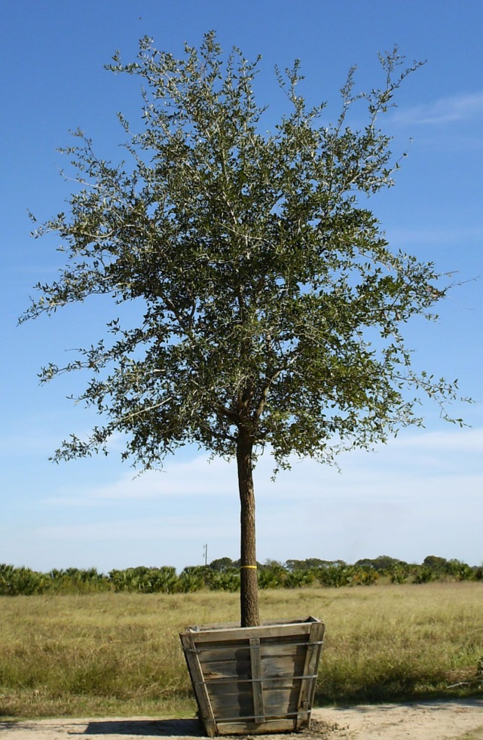
Unit Cost
LCANT
Largest
Commonly Available
Nursery
Tree

Slide 6
Unit Cost
LCANT Median Cost
LCANT Trunk Area

Slide 7
Selecting Unit Cost
Universal LCANT and Unit Cost
Universal LCANT and segment for Unit Cost
Segment for both LCANT and Unit Cost

Slide 8
Selecting Unit Cost
Universal LCANT and Unit Cost
Universal LCANT and segment for Unit Cost
Segment for both LCANT and Unit Cost

Slide 9
Selecting Unit Cost
ISA Ontario
ISAO, 1997

Slide 10
Selecting Unit Cost
ISA Southern, 2005

Slide 11
Selecting Unit Cost
Universal LCANT and Unit Cost
Universal LCANT and segment for Unit Cost
Segment for both LCANT and Unit Cost

Slide 12
Selecting Unit Cost
Penn-Del Chapter, 1993

Slide 13
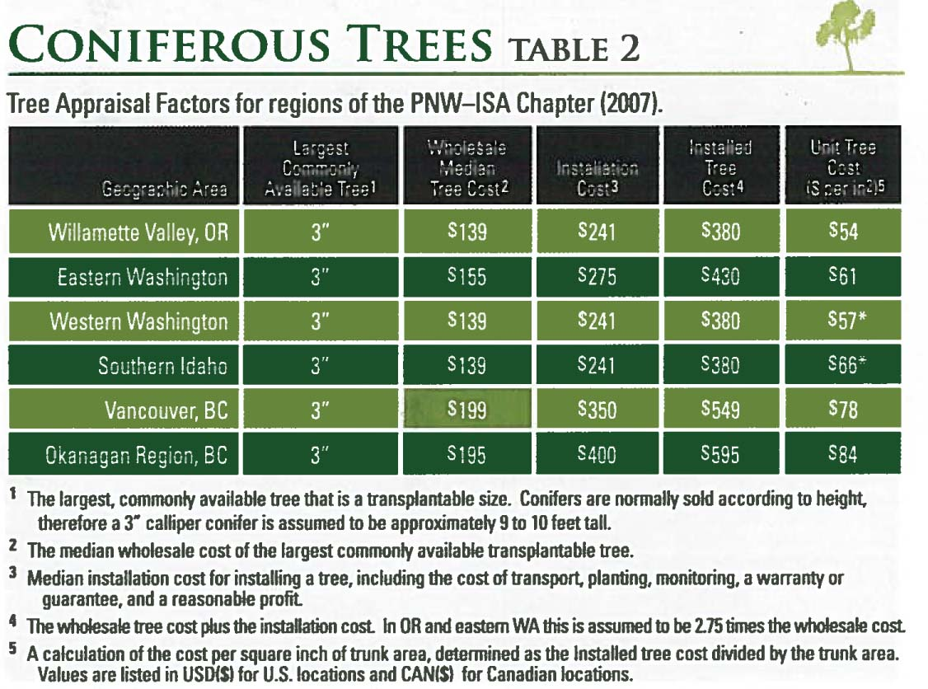
Selecting Unit Cost
PNW Chapter, 2007

Slide 14
Selecting Unit Cost
Universal LCANT and Unit Cost
Universal LCANT and segment for Unit Cost
Segment for both LCANT and Unit Cost

Slide 15
Selecting Unit Cost
Western Chapter, 2004

Slide 16
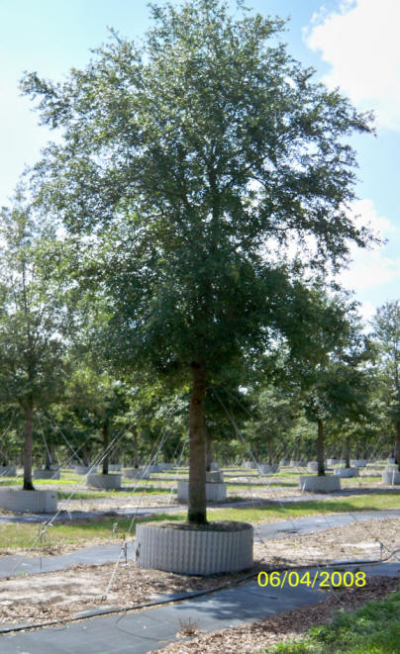
Selecting LCANT
Number of taxa at size
Number of trees at size
Number of nurseries supplying size

Slide 17
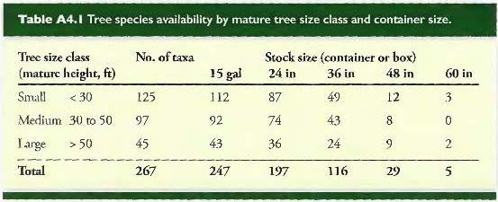
Selecting LCANT
Number of taxa at size
Notes:
Table published in GPA10

Slide 18
Selecting LCANT
Number of taxa at size
One uniform LCANT for all calculations
Least amount of data collection required
Some species many not be available at that size
Notes:
Table published in GPA10

Slide 19
Selecting LCANT
Number of taxa at size
Number of trees at size
Complete nursery inventory data required
Can be fixed or segmented
Costly data collection
Proprietary data

Slide 20
Selecting LCANT
Number of taxa at size
Number of trees at size
Number of nurseries supplying size
Moderate amount of data required
Public information
Can be fixed or segmented

Slide 21
Query 1
May 2016
Included proprietary data
Entire U.S. Nursery Database n > 1,000
Notes:
HMI is a company that provides claim support services to the insurance industry. It maintains a comprehensive database of wholesale nursery pricing on trees and shrubs. As an ongoing process, HMI aggregates data from tree catalogs from more than one thousand wholesale nurseries around the country and uses the data for its own internal tree appraisal assignments. I have utilized HMI’s database for many of my appraisal assignments in the past.

Slide 22
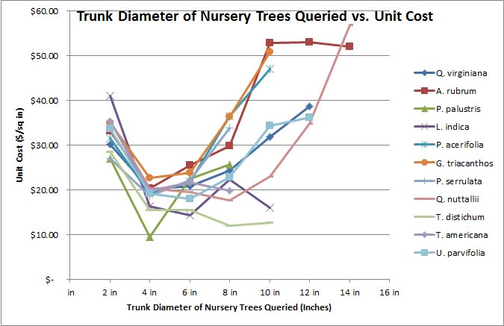
Query 1

Slide 23
Query 2
July 2019
Public data only
Southeast (NC, SC, GA) n = 19
Northeast (NJ, NY, PA) n = 17
TN (McMinnville Market) n = 15
Notes:
HMI is a company that provides claim support services to the insurance industry. It maintains a comprehensive database of wholesale nursery pricing on trees and shrubs. As an ongoing process, HMI aggregates data from tree catalogs from more than one thousand wholesale nurseries around the country and uses the data for its own internal tree appraisal assignments. I have utilized HMI’s database for many of my appraisal assignments in the past.

Slide 24
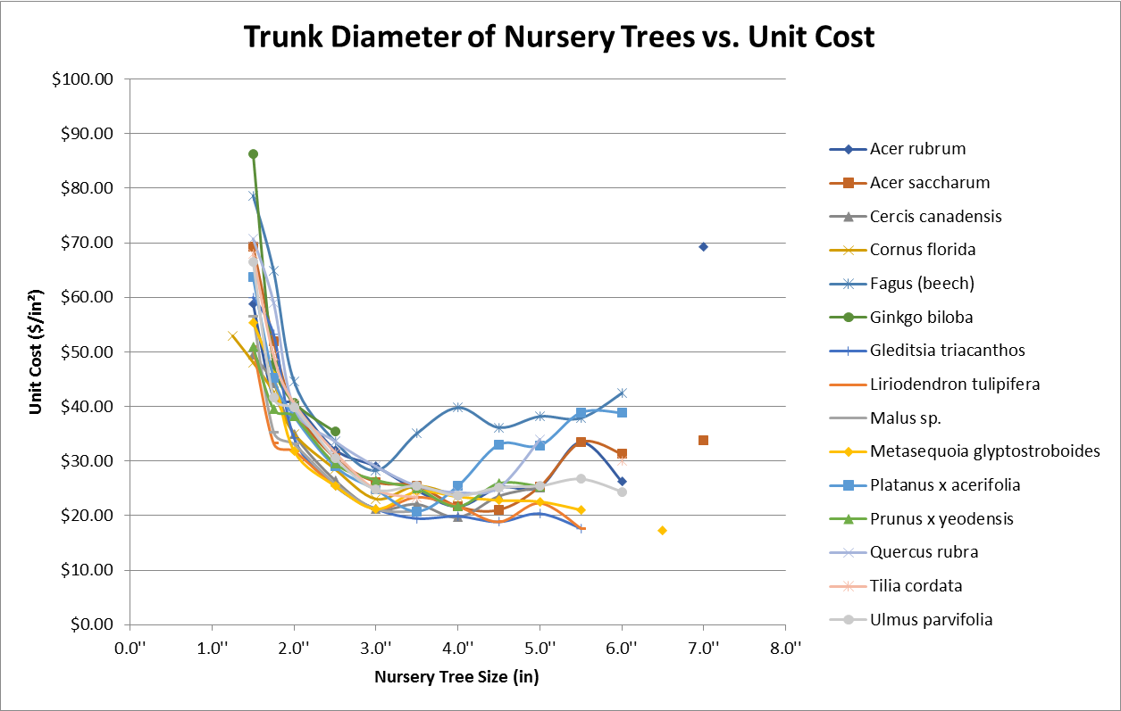
Query 2

Slide 25
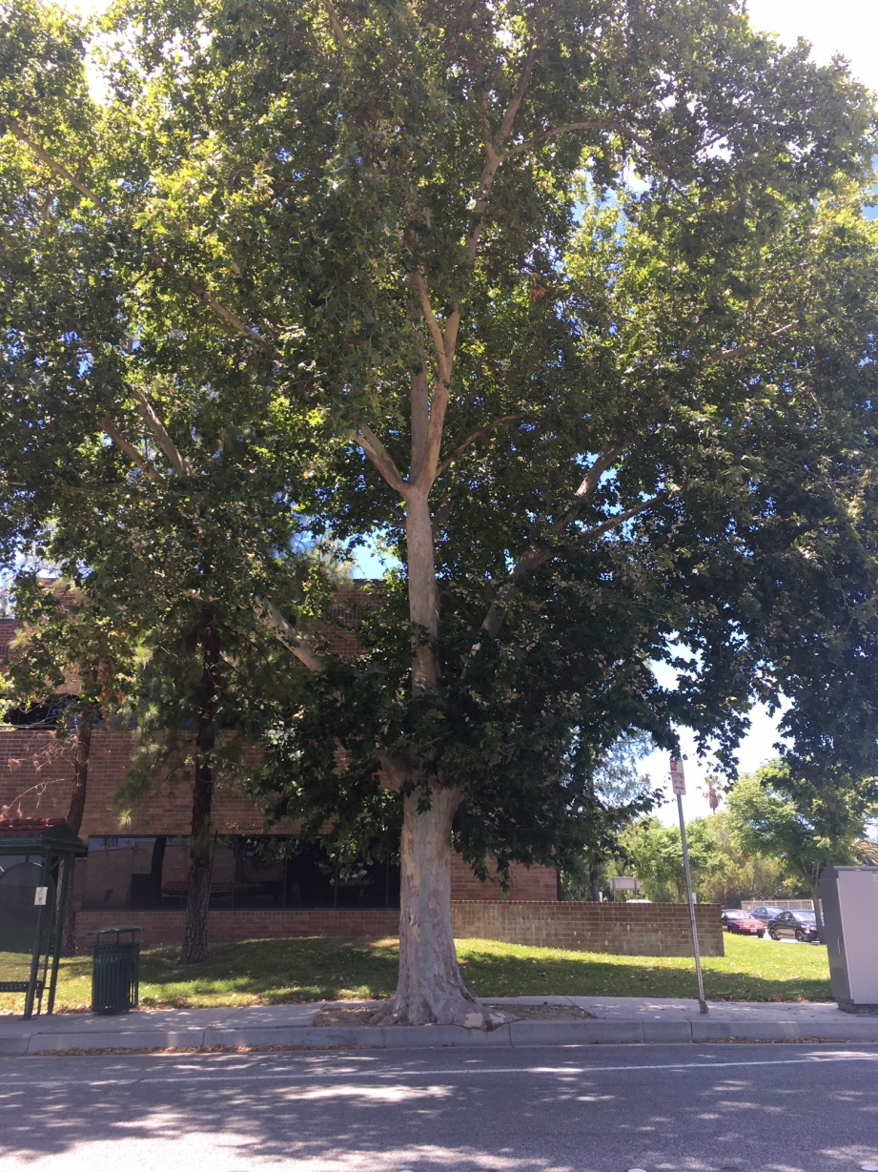
Example Tree 1
Platanus x hispanica
16” DBH

Slide 26
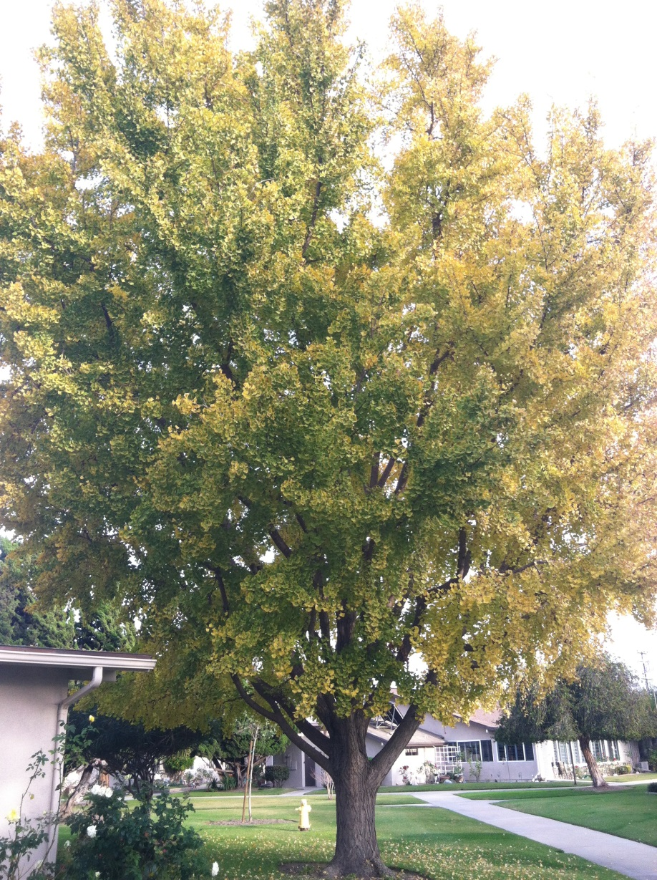
Example Tree 2
Ginkgo biloba
16” DBH

Slide 27
Fixed Unit Cost
LCANT: 3.0”
Unit Cost: $24.62 / in²
Basic Cost: $7,518
LCANT: 3.0”
Unit Cost: $24.62 / in²
Basic Cost: $7,518
Notes:
Unit Cost fixed for all trees. LCANT fixed by southern chapter consensus (survey)
It’s irrelevant that Ginkgo is not available in that size in any of the nurseries I queried because the universal unit cost is by definition uniform for all species.

Slide 28
Fixed LCANT
LCANT: 3.0”
Unit Cost: $24.76 / in²
Basic Cost: $7,702
LCANT: 3.0”
Unit Cost: $35.37 / in²
Basic Cost: $11,002
Notes:
LCANT Fixed by chapter survey, unit cost calculated for each species
Ginkgo not available in that size from any of the 19 nursery catalogs queried

Slide 29
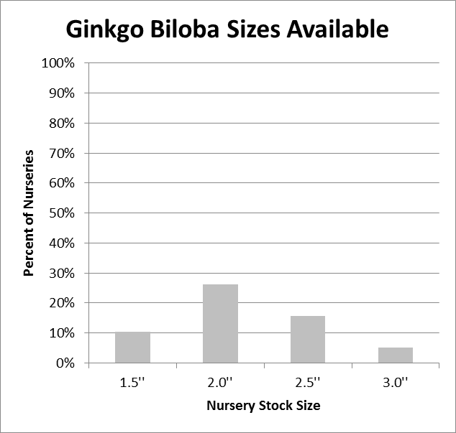
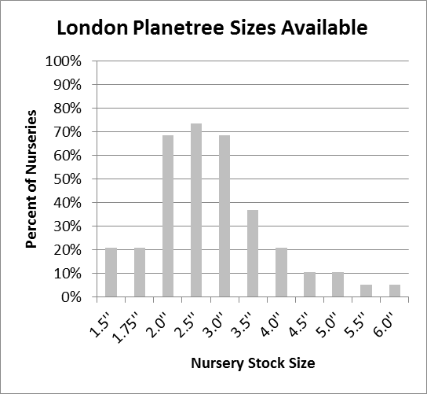
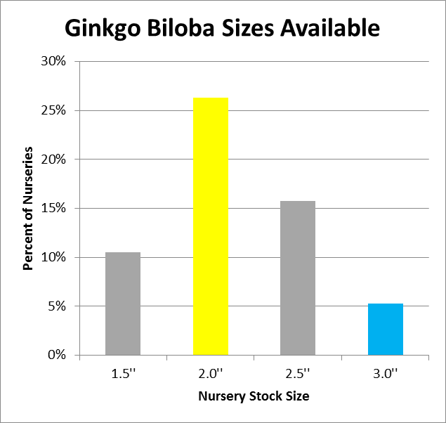
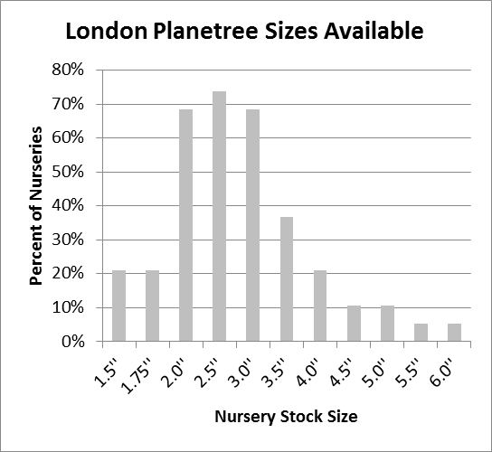
Species LCANT
Notes:
What if we determine LCANT more objectively than by consensus? What metric can we use?
LCANT calculated for each species by looking at frequency of availability

Slide 30
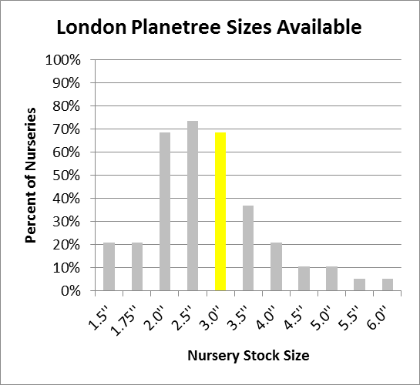
Species LCANT (50%)
Notes:
LCANT calculated for each species by looking at frequency of availability
No size of Ginkgo was supplied by at least 50% of all queried nurseries.

Slide 31
Species LCANT (50%)
LCANT: 3.0”
Unit Cost: $24.76 / in²
Basic Cost: $7,704
LCANT: ***
Unit Cost: $**** / in²
Basic Cost: $****
Notes:
LCANT calculated for each species, Unit Cost Calculated for each species
No size of Ginkgo was supplied by at least 50% of all queried nurseries.

Slide 32
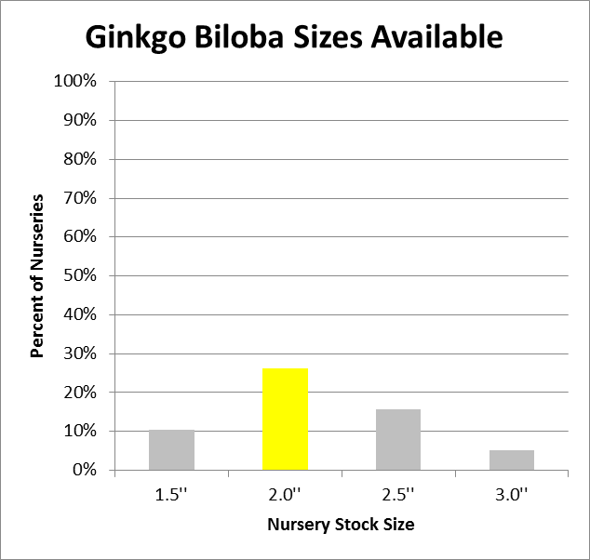
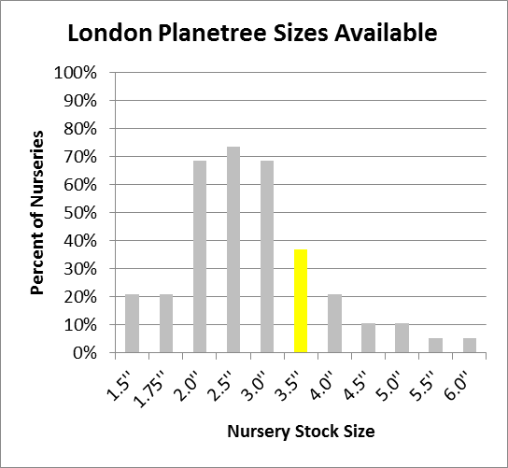
Species LCANT (25%)

Slide 33
Species LCANT (25%)
LCANT: 3.5”
Unit Cost: $20.79 / in²
Basic Cost: $5,431
LCANT: 2.0”
Unit Cost: $47.75 / in²
Basic Cost: $28,652
Notes:
LCANT calculated for each species, Unit Cost Calculated for each species

Slide 34
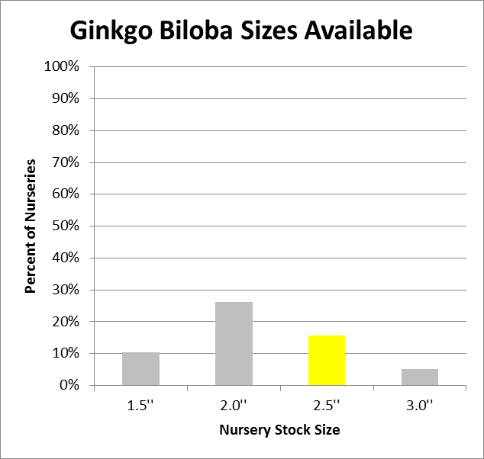
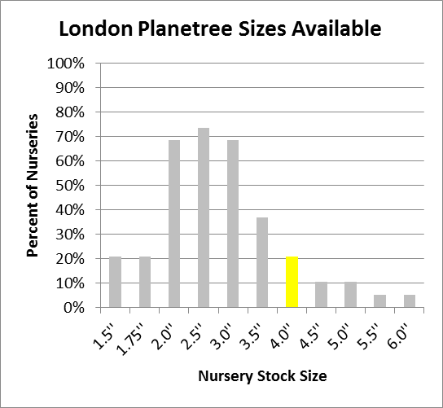
Species LCANT (15%)
Notes:
Perhaps: size carried by at least x% nurseries OR if no size carried by x% nurseries, then most commonly carried size

Slide 35
Species LCANT (15%)
LCANT: 4”
Unit Cost: $25.46 / in²
Basic Cost: $8,146
LCANT: 2.5”
Unit Cost: $40.74 / in²
Basic Cost: $20,857
Notes:
LCANT calculated for each species, Unit Cost Calculated for each species
Although I only calculated the results based on % of nurseries, the magnitude of difference between the results would be similar if the LCATT were determined on % of available taxa.

Slide 36
Takeaways

Slide 37
Takeaways
Unit Cost is different for each size and species

Slide 38
Takeaways
Choice of LCANT can have a large effect on Basic Cost
LCANT: 2”
Unit Cost: $47.75 / in²
Basic Cost: $28,652
LCANT: 2.5”
Unit Cost: $40.74 / in²
Basic Cost: $20,857
LCANT: 3”
Unit Cost: $24.62 / in²
Basic Cost: $7,518

Slide 39
How Nursery Stock Unit Cost Affects Trunk Formula Technique Appraisals
Unit Cost and the Trunk Formula Technique
James Komen
BCMA #WE-9909B
RCA #555
August 13, 2019
Notes:
Your local RPACs are hard at work developing the newest editions of your regional guides. These are the challenges that will face them in the coming months.
If you want to get involved, I encourage you to reach out to your chapter to help contribute to the development of these guides.
Thank you to HMI for providing the data used in this research.

